Slide 1

CONTENTS
6-1 Pronunciation of final -s/-es
6-2 Plural forms of nouns
6-3 Subjects, verbs, and objects
6-4 Objects of prepositions
6-5 Prepositions of time
6-6 Word order: place and time
6-7 Subject – verb agreement
6-8 Using adjectives to describe nouns
6-9 Using nouns as adjectives
6-10 Personal pronouns: subjects and objects
6-11 Possessive nouns
6-12 Possessive pronouns and adjectives
6-13 Reflexive pronouns
6-14 Singular forms of other: another vs. the other
6-15 Plural forms of other: other(s) vs. the other(s) 6-16 Summary of forms of other

Slide 2
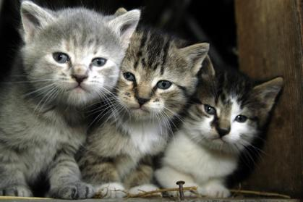
6-1 PRONUNCIATION OF FINAL -S/-ES
cats = cat/z/

Slide 3
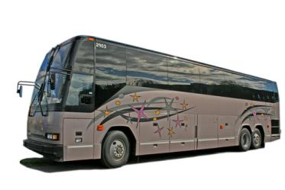
6-1 PRONUNCIATION OF FINAL -S/-ES
(a) eats = eat/s/
taps = tap/s/
bikes = bike/s/
/s/ as in “bus”
voiceless sounds

Slide 4
6-1 PRONUNCIATION OF FINAL -S/-ES
(a) eats = eat/s/
taps = tap/s/
bikes = bike/s/
/s/ as in “bus”
voiceless sounds
examples: /t/, /p/, /k/

Slide 5
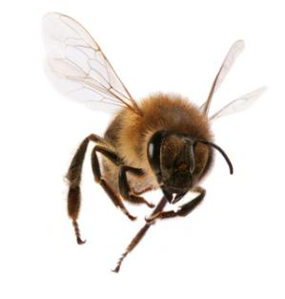
6-1 PRONUNCIATION OF FINAL -S/-ES
(b) reads = read/z/
jars = jar/z/
tolls = toll/z/
paws = paw/z/
/z/ as in “buzz”
voiced sounds

Slide 6
6-1 PRONUNCIATION OF FINAL -S/-ES
(b) reads = read/z/
jars = jar/z/
tolls = toll/z/
paws = paw/z/
/z/ as in “buzz”
voiced sounds
examples: /d/, /r/, /l/, /m/, /b/, all vowel sounds

Slide 7
6-1 PRONUNCIATION OF FINAL -S/-ES
(c) wishes = wish/ z/
catches = catch/ z/
glasses = glass/ z/
sizes = size/ z/
wages = wage/ z/
judges = judge/ z/
ә
ә
ә
ә
ә
ә
/ z/ adds a syllable
–s/–es pronounced / z/
ә
ә

Slide 8
6-1 PRONUNCIATION OF FINAL -S/-ES
(c) wishes = wish/ z/
catches = catches/ z/
glasses = glass/ z/
sizes = size/ z/
wages = wage/ z/
judges = judge/ z/
ә
ә
ә
ә
ә
ә
/ z/ adds a syllable
-s/-es pronounced / z/ after
–sh, –ch, –s, –z, –ge / –dge sounds
ә
ә

Slide 9
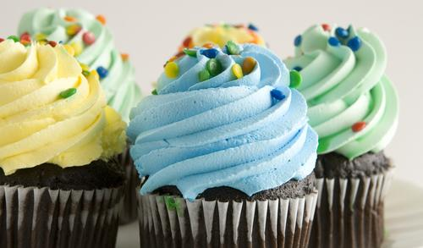
6-1 LET’S PRACTICE
a. /s/
b. /z/
c. / z/
/s/
cupcakes = cupcake__
e

Slide 10
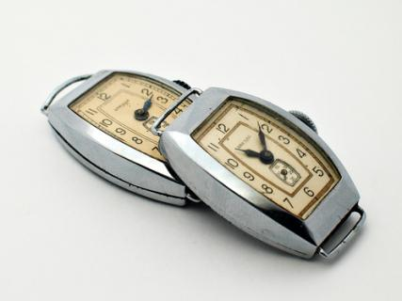
6-1 LET’S PRACTICE
a. /s/
b. /z/
c. / z/
/ z/
watches = watch___
e
e

Slide 11
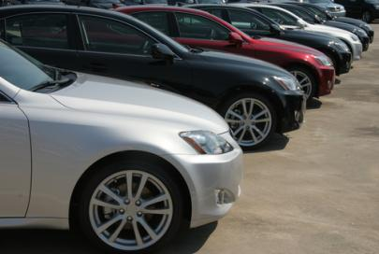
6-1 LET’S PRACTICE
a. /s/
b. /z/
c. / z/
/z/
cars = car__
e

Slide 12
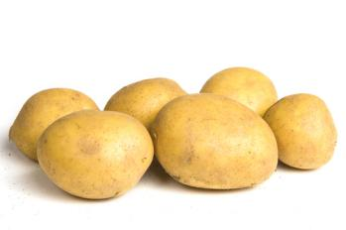
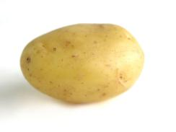
6-2 PLURAL FORMS OF NOUNS
one potato
six potatoes

Slide 13
6-2 PLURAL FORMS OF NOUNS
SINGULAR
PLURAL
(a)
one dream two dreams
one boat two boats
one shoe two shoes
most plural nouns
add –s

Slide 14
6-2 PLURAL FORMS OF NOUNS
SINGULAR
PLURAL
(b)
one wish two wishes
one latch two latches
one glass two glasses
one mix two mixes
endings: –sh, –ch, –ss, –x
add –es

Slide 15
6-2 PLURAL FORMS OF NOUNS
SINGULAR
PLURAL
(c)
one story two stories
one party two parties
endings: consonant + –y
–y –i and add –es

Slide 16
6-2 PLURAL FORMS OF NOUNS
SINGULAR
PLURAL
(d)
one boy two boys
one ray two rays
endings: vowel + –y
add –s

Slide 17
6-2 PLURAL FORMS OF NOUNS
SINGULAR
PLURAL
(e)
one life two lives
one elf two elves
Exceptions:
beliefs, chiefs,
roofs, cuffs, cliffs
endings: –fe or –f
–fe or –f –ves

Slide 18
6-2 PLURAL FORMS OF NOUNS
SINGULAR
PLURAL
(g)
one child two children
one goose two geese
one tooth two teeth
irregular plural forms

Slide 19
6-2 PLURAL FORMS OF NOUNS
SINGULAR
PLURAL
(h)
one deer two deer
one sheep two sheep
one species two species
plural form = singular form

Slide 20
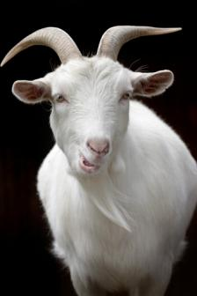
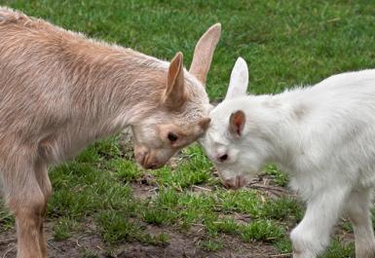
6-2 LET’S PRACTICE
one goat
goats
two ______

Slide 21
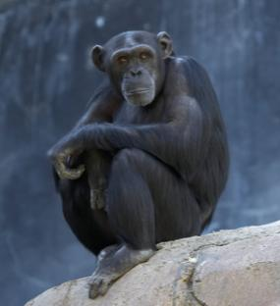
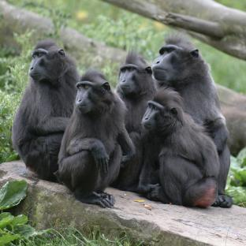
6-2 LET’S PRACTICE
one ape
many ____
apes

Slide 22
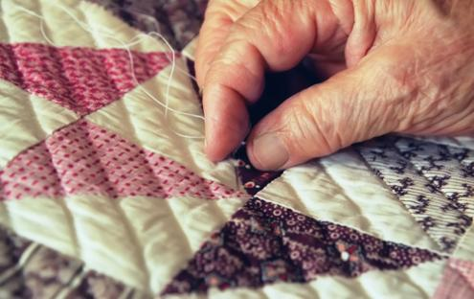
6-2 LET’S PRACTICE
one stitch
many ______
stitches

